Slide 1




Slide 2
Our Idea
A website that lets random strangers on the internet communicate through a collaborative art piece.

Slide 3
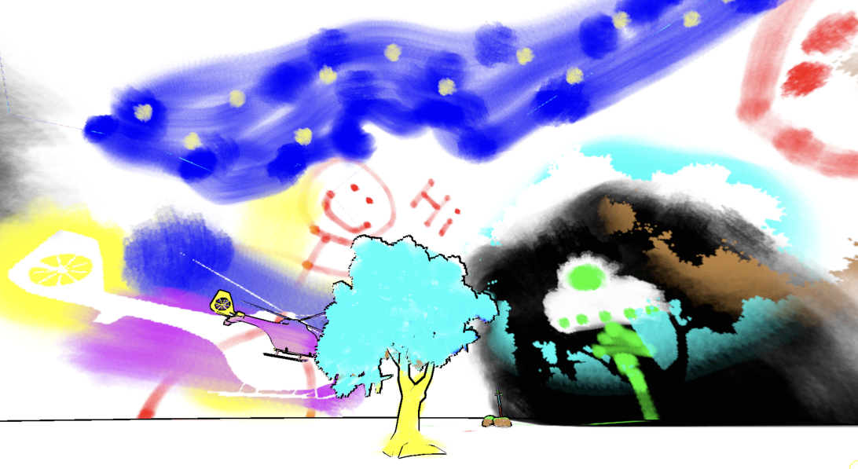
The Inspiration For Our Project

Slide 4
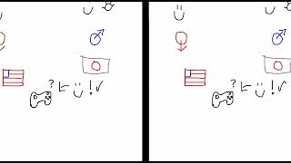

Slide 5
drawwithstrangres.onrender.com
Server
React
Searching
Connected
Client
Client
Client

Slide 6
drawwithstrangres.onrender.com
Server
React
Canvas Update Data Package
Searching
Connected
Client
Client
Client

Slide 7
drawwithstrangres.onrender.com
Server
React
Canvas Update Data Package
Searching
Connected
Client
Client
Client

Slide 8
drawwithstrangres.onrender.com
Server
React
Lost Partner
Searching
Disconnected
Client
Client
Client

Slide 9
drawwithstrangres.onrender.com
Server
React
Searching
Searching
Disconnected
Client
Client
Client

Slide 10
drawwithstrangres.onrender.com
Server
React
Connected
Connected
Disconnected
Client
Client
Client

Slide 11
Drawing Data
{
x1: number, // Starting X coordinate of the line
y1: number, // Starting Y coordinate of the line
x2: number, // Ending X coordinate of the line
y2: number, // Ending Y coordinate of the line
color: string, // Color in hex format (e.g., "#FF0000" for red)
size: number // Line thickness in pixels
}
Send drawing object to server
Client interprets drawing data from transferred “drawing objects”. Vectors with color and width information
Interpret drawing object onto canvas

Slide 12
Future Plans
Near
Add more drawing tools (brushes and fill bucket)
On the horizon
Market the website to increase the user base.
Let users save the artwork they’ve created.
soon
Increase the traffic capacity of our server.
Distant

Slide 13
Final Remarks
Were happy to have learned tools and architecture we weren’t familiar with to create something fun we can share with the world.

Slide 14
